Slide 1
Aditya Mysore Ramesh
Avaneesh Yembadi
Kashish Desai
Swapnil Patil
Team Byte-Me
University Application Portal - ADMIT

Slide 2

Purpose
ADMIT is a University Application Portal that allows Students & Universities to connect on a single platform.
Students can view multiple universities around the world and apply to their programs through a single common portal.
Students can view different programs and specializations of a particular university and shortlist it to apply at a later stage.
This portal allows students to plan, apply & track applications efficiently.
A second portal -> University admin portal allows the university officials to view the applications and make an accept or a reject decision.
Notes:
Ketan

Slide 3
Tech-Stack
ReactJS & React-Bootstrap
React router dom(for routing)
Redux Toolkit & RTK Query
ExpressJS (for backend)
MongoDB atlas (database)
Brcrypt (for hashing passwords)
Multer (For File upload)
JWT (for authentication)
Sass (for styling)
NodeJS (as a package manager)

Slide 4
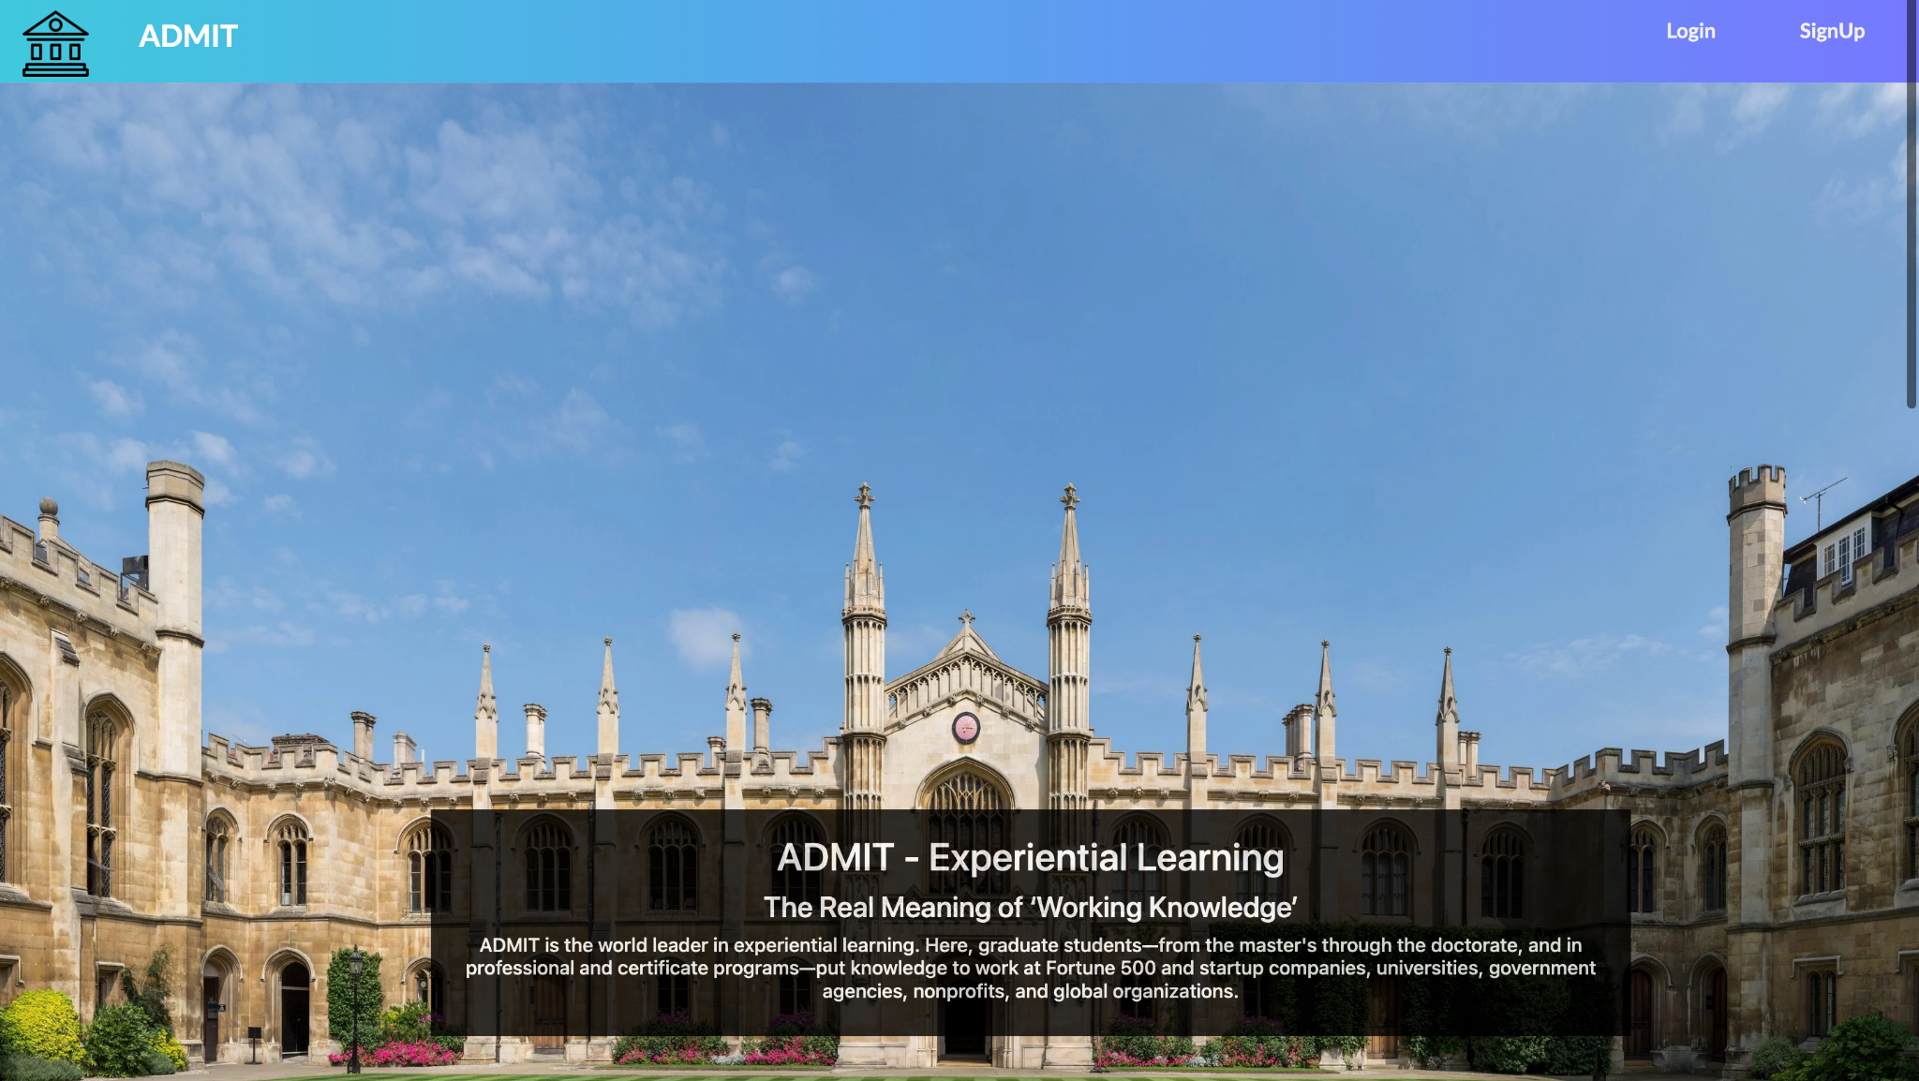
Demo

Slide 5
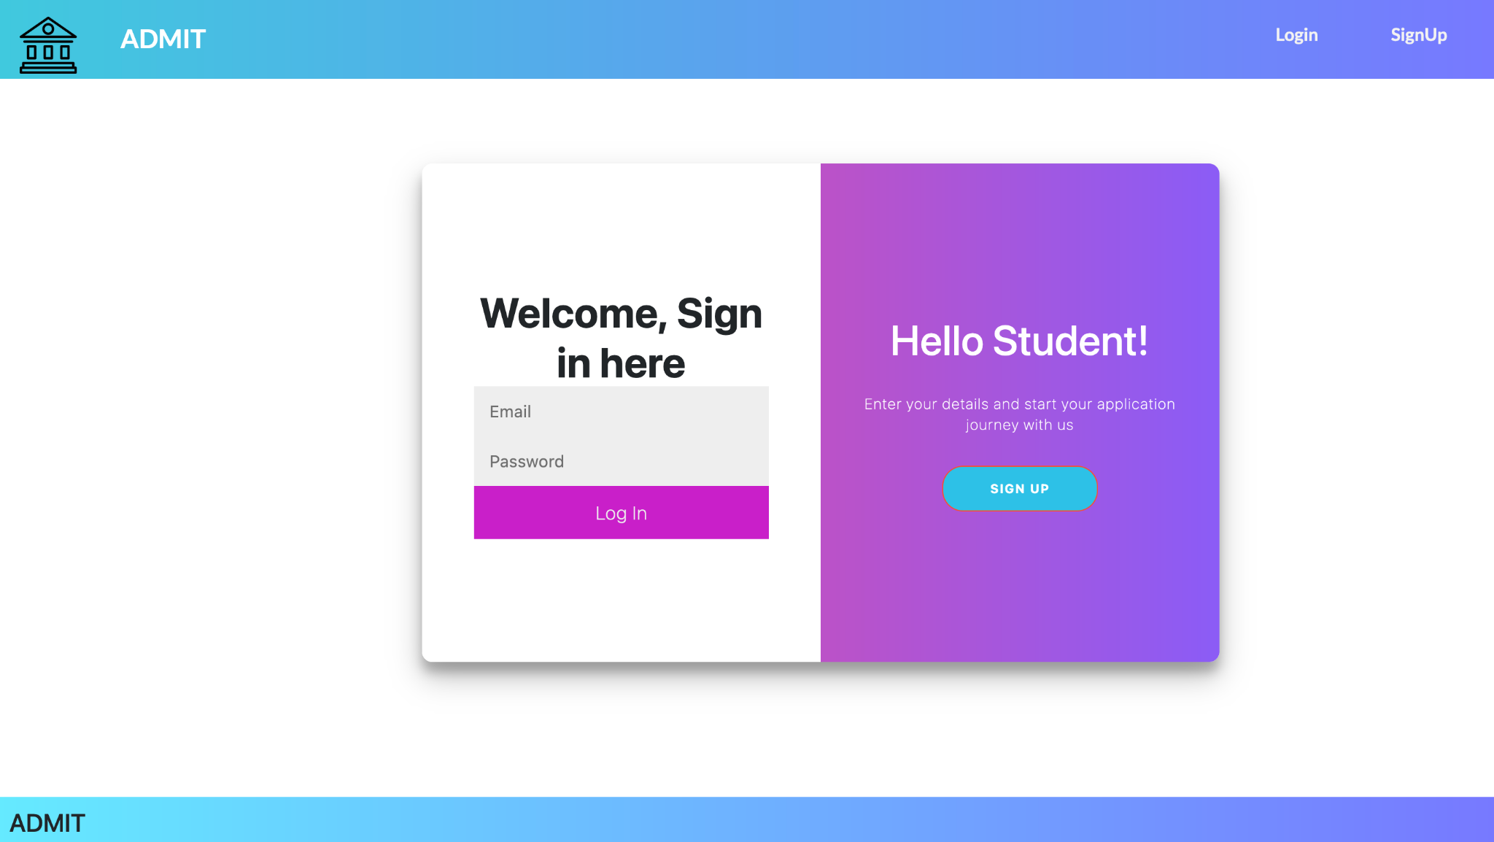
Demo

Slide 6
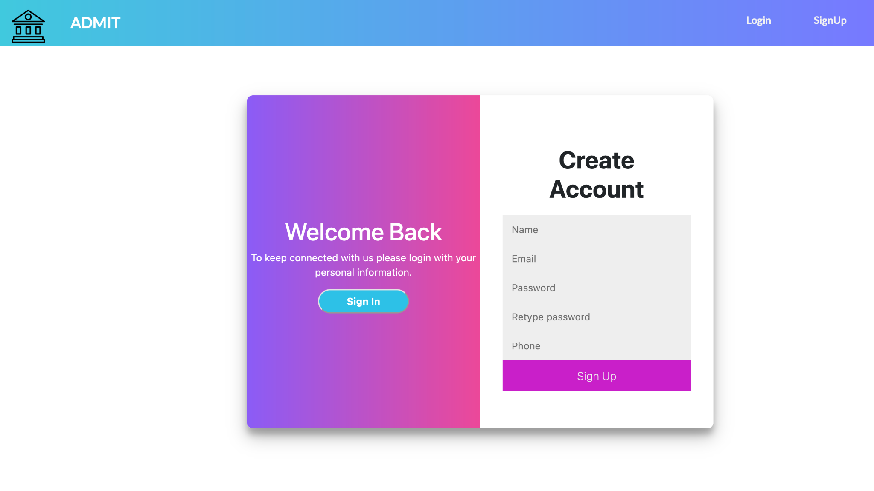
Demo

Slide 7
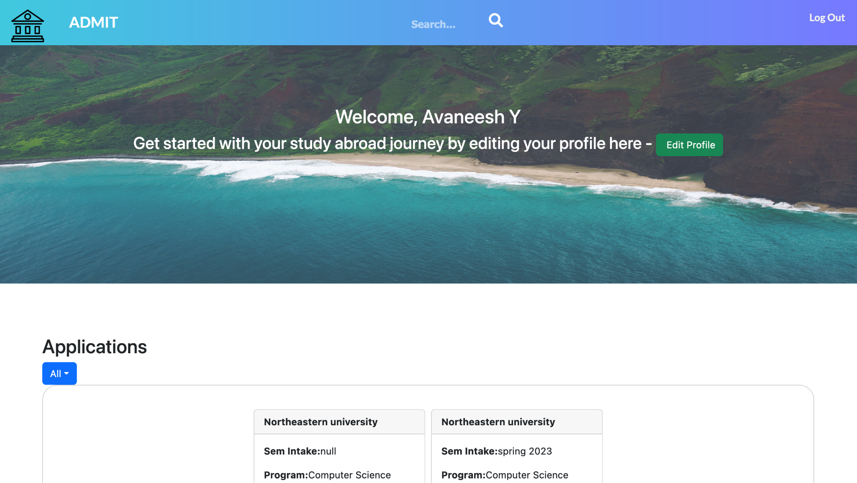
Landing Page

Slide 8
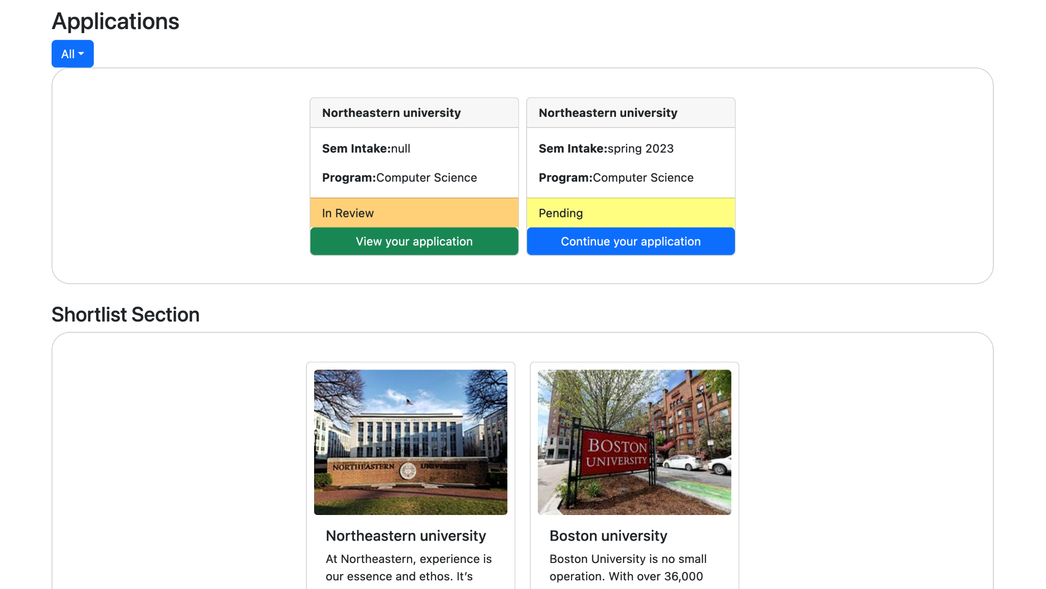
Demo

Slide 9
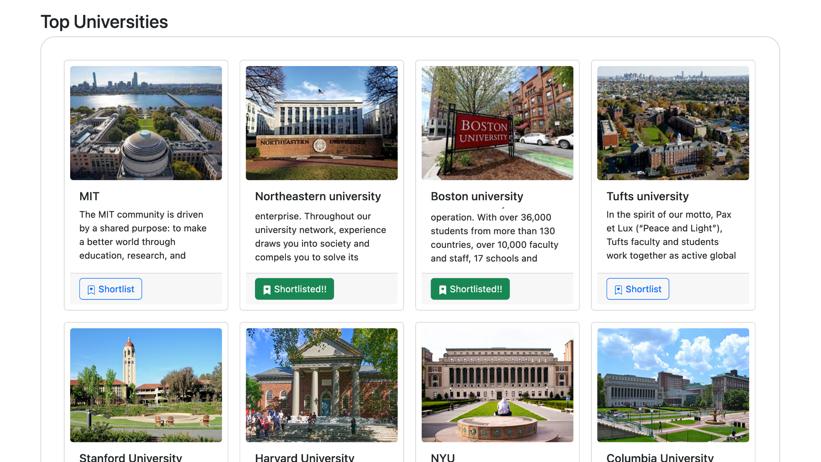
Demo

Slide 10
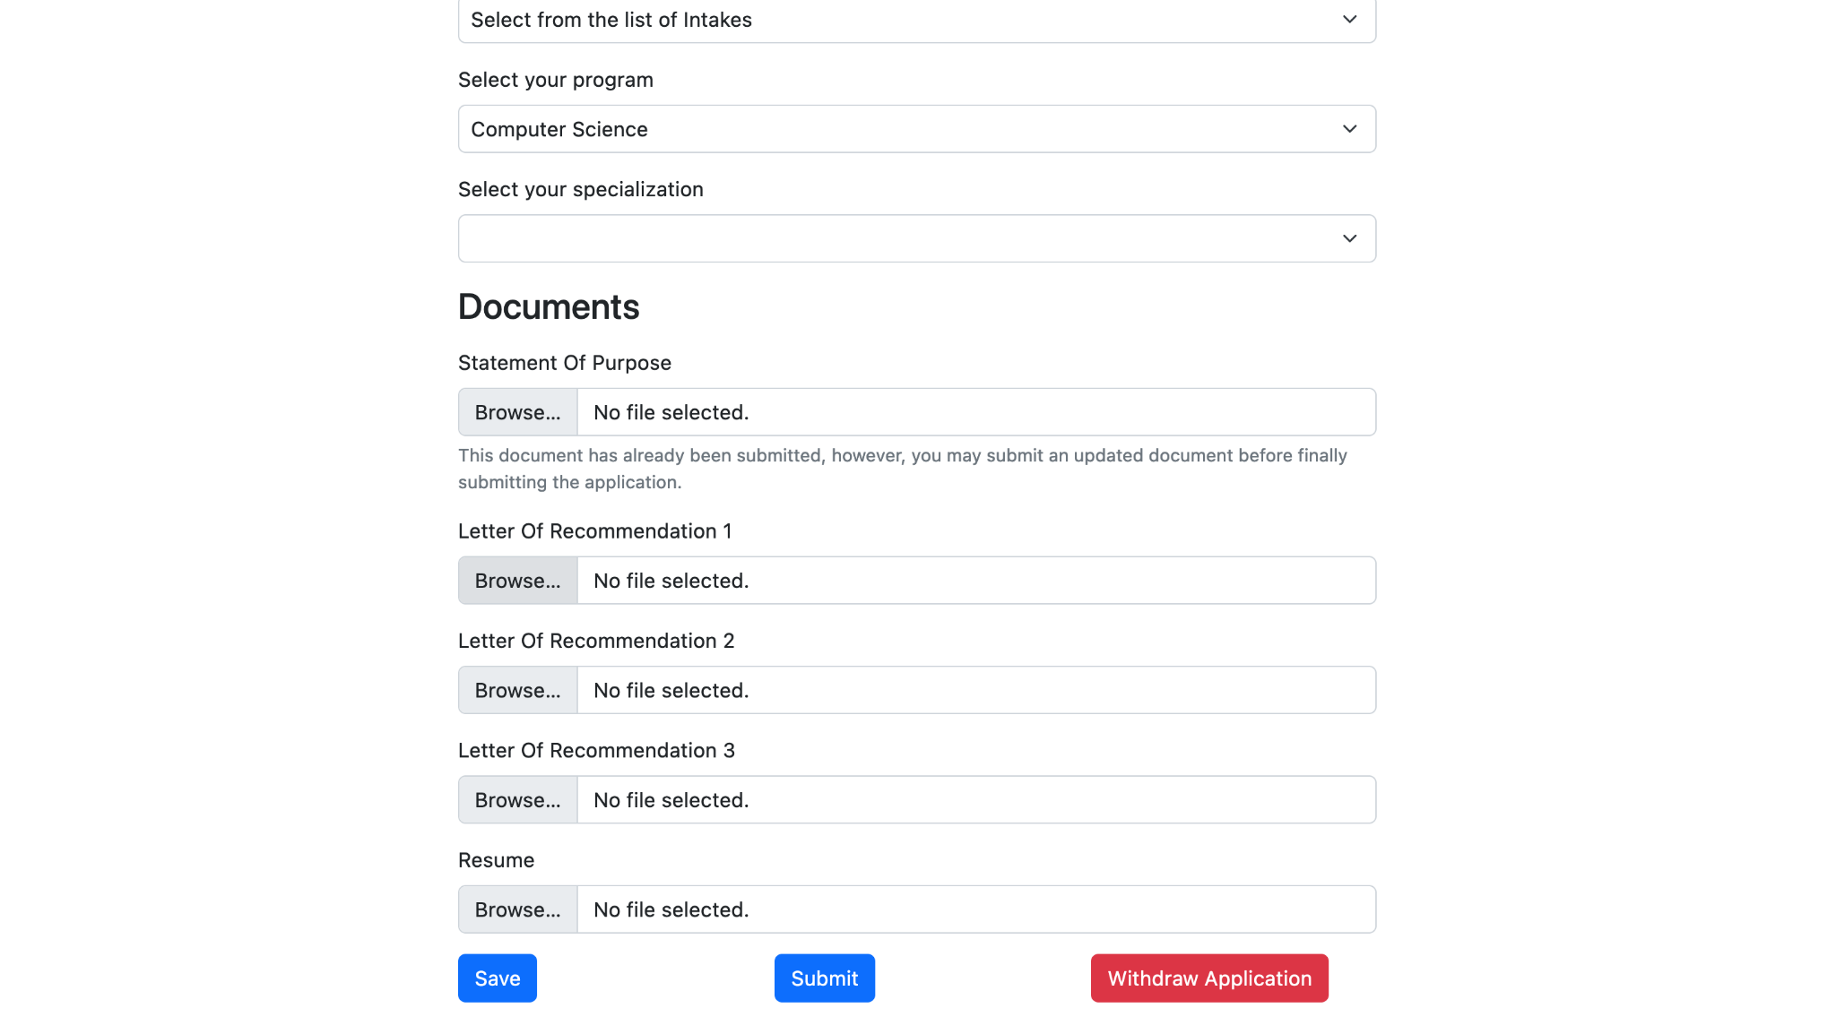
Demo - Edit Application

Slide 11
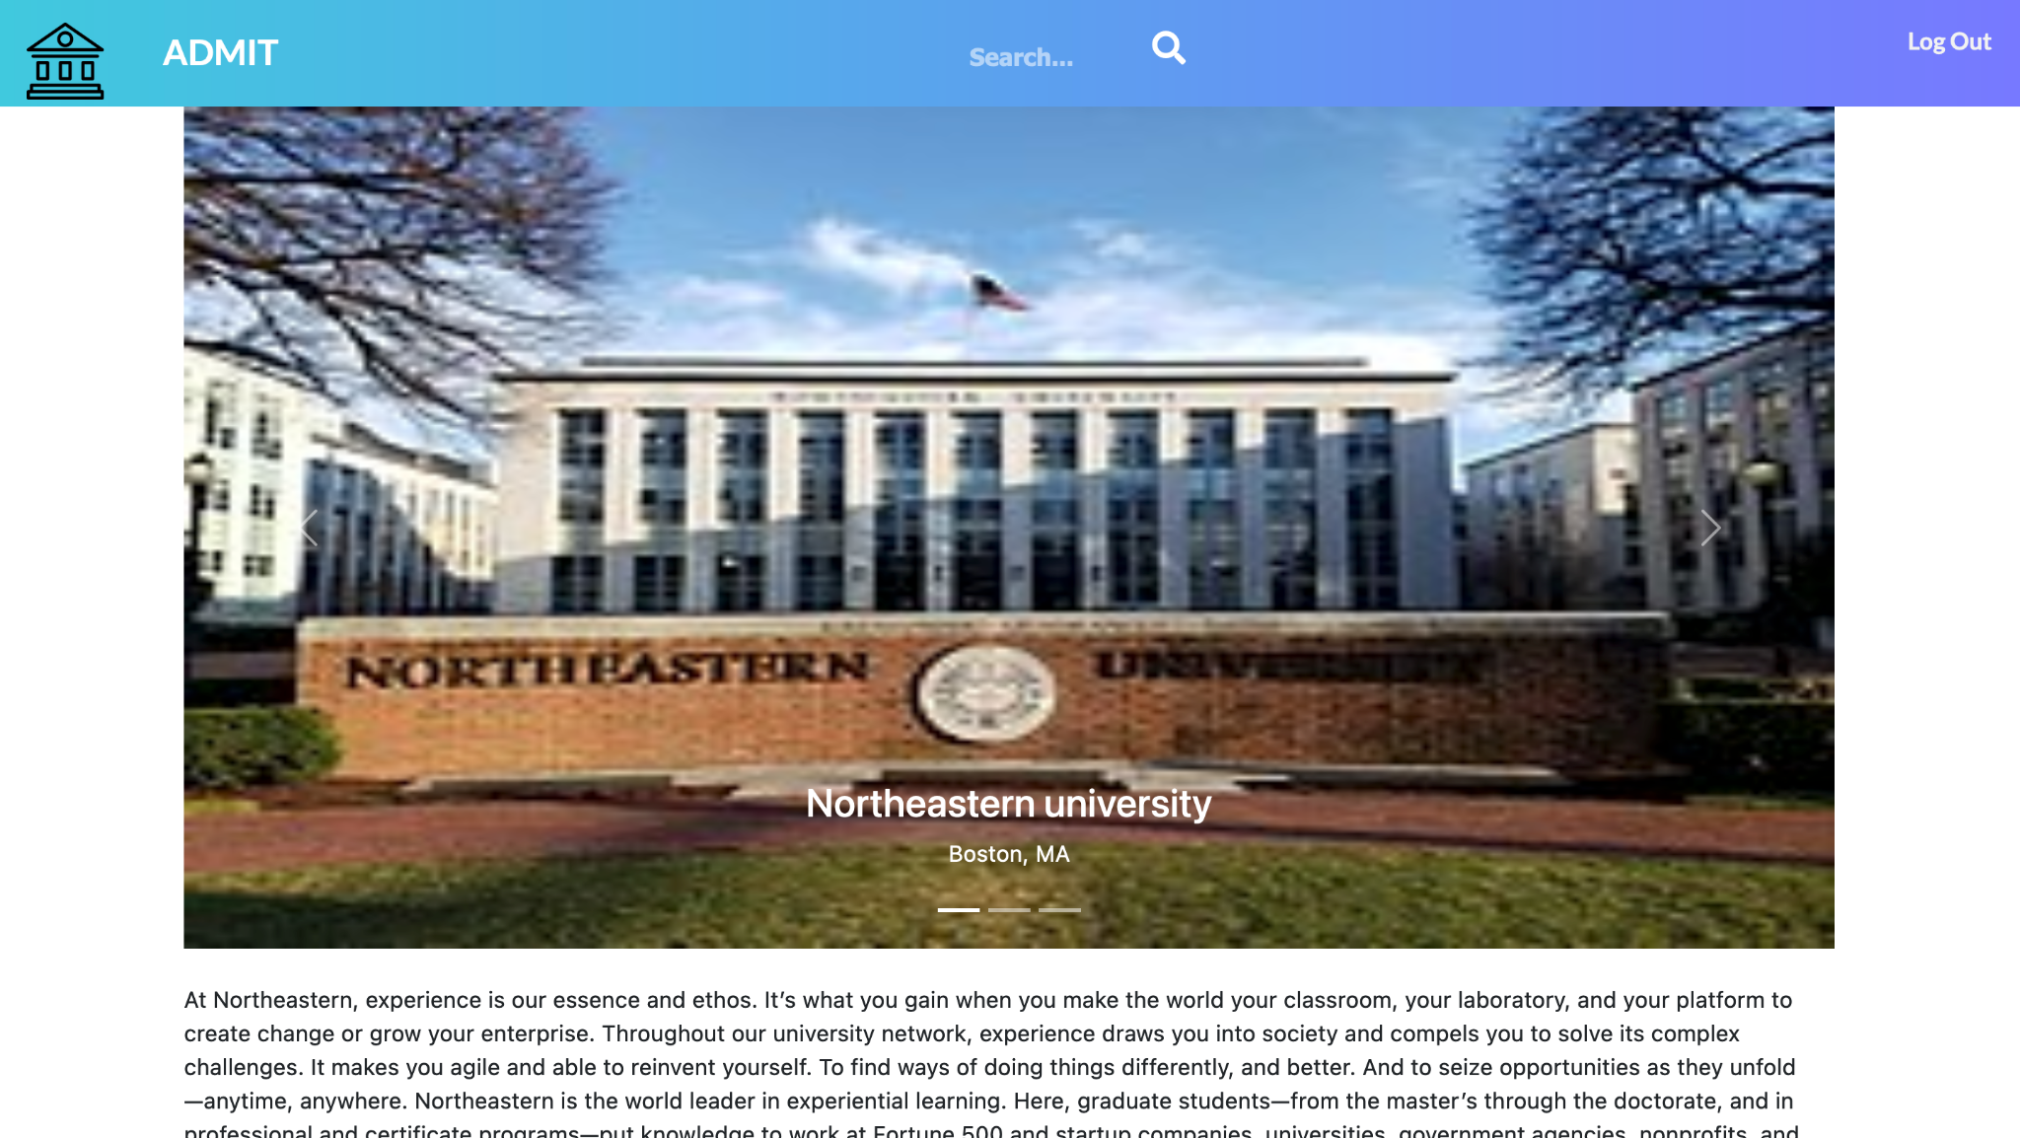
Demo

Slide 12
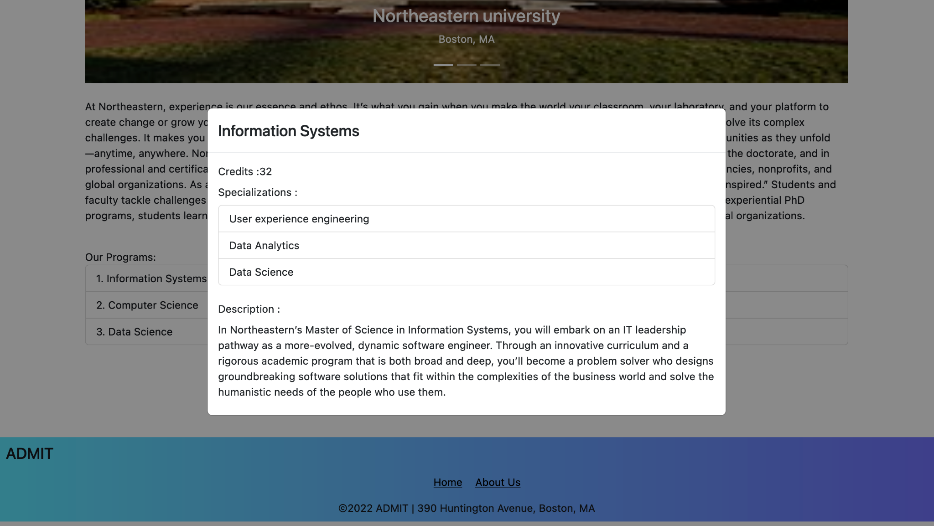
Demo

Slide 13
Demo

Slide 14
Demo

Slide 15
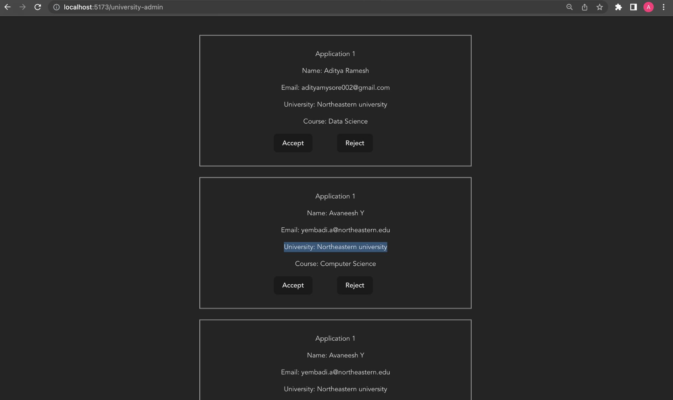
University Admin: Admit/Reject

Slide 16

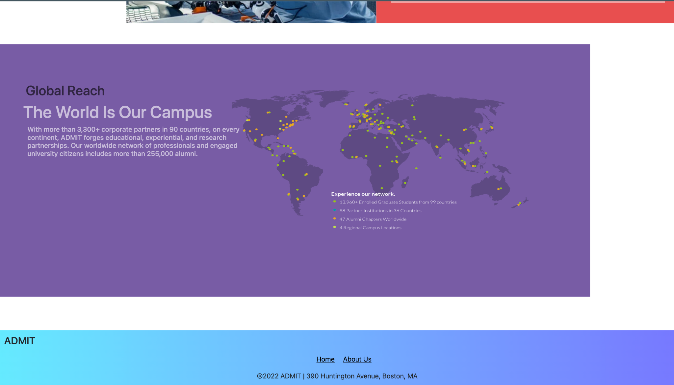
Screenshots

Slide 17
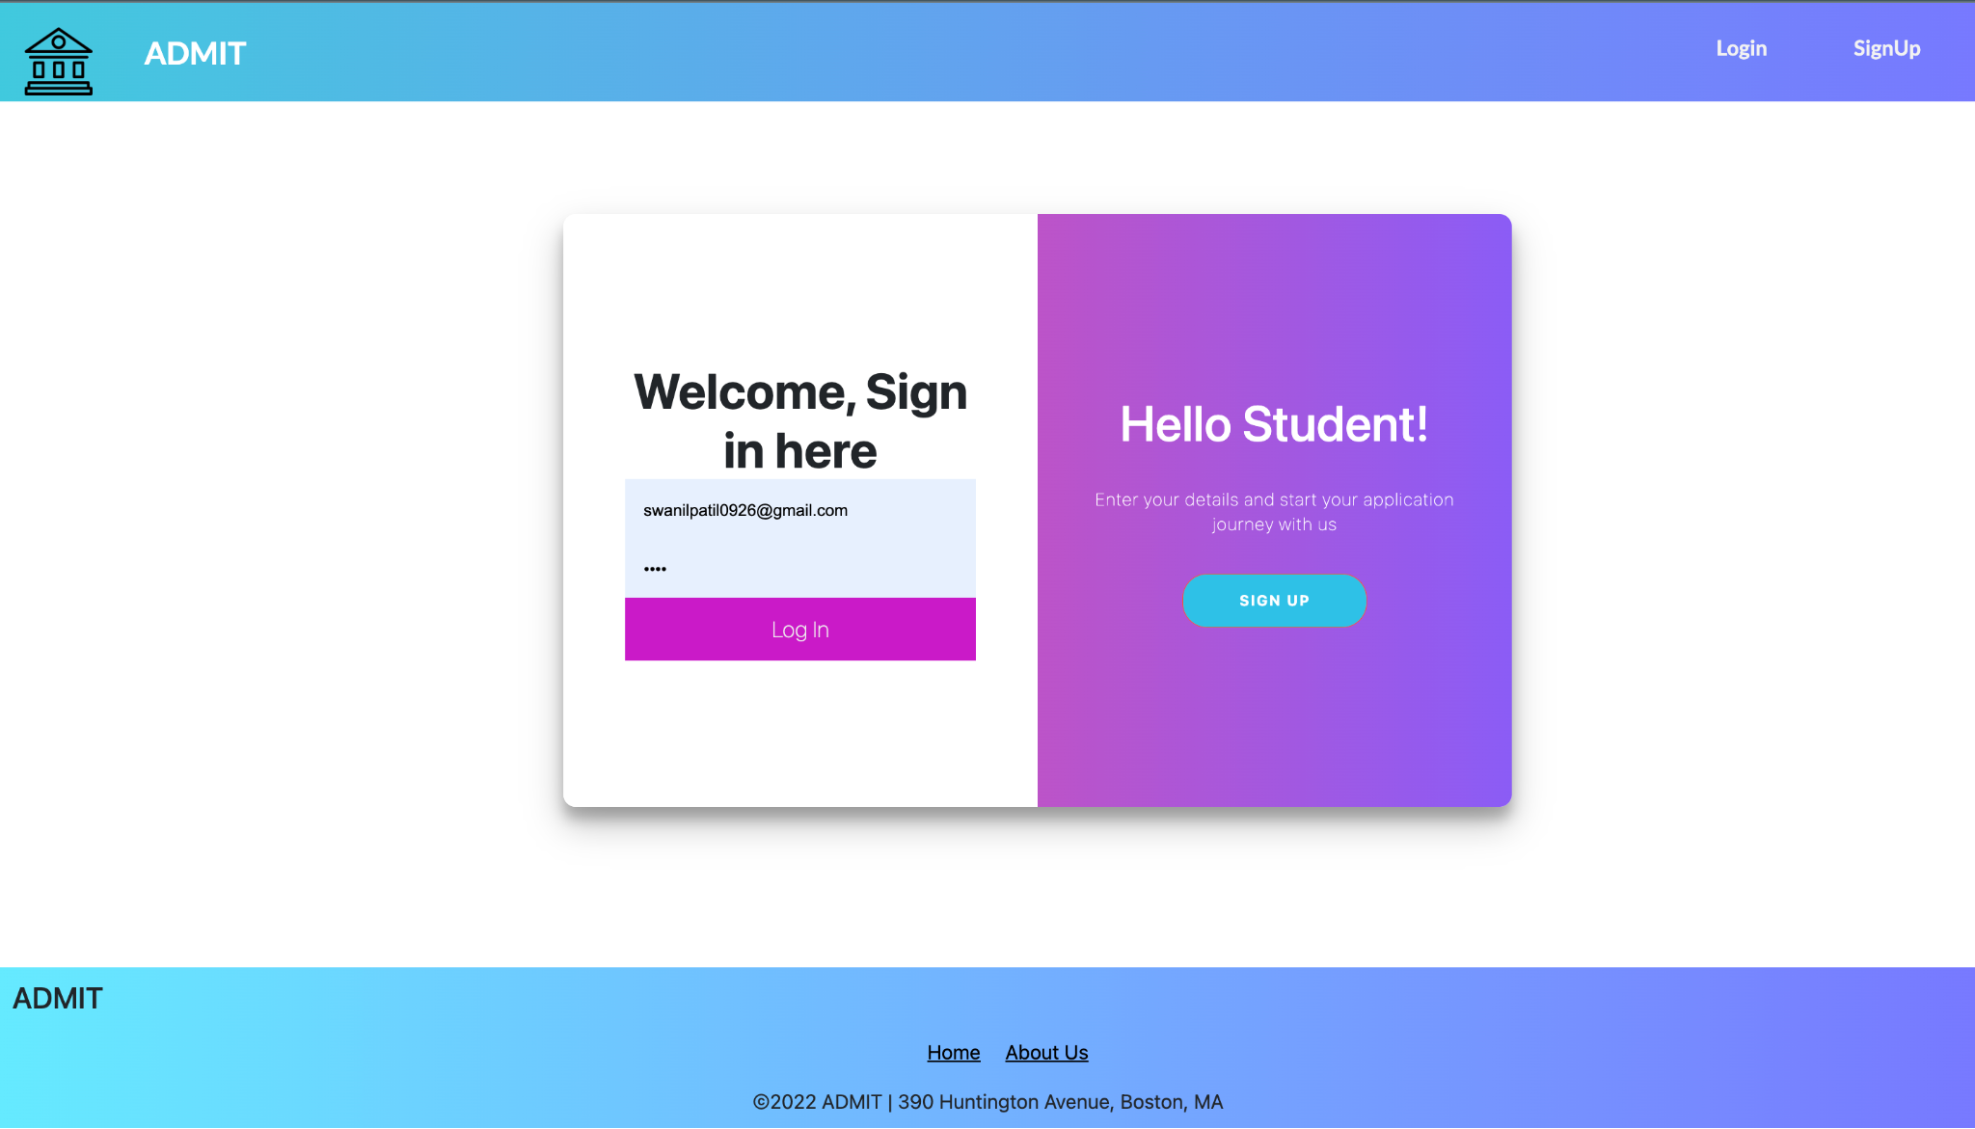
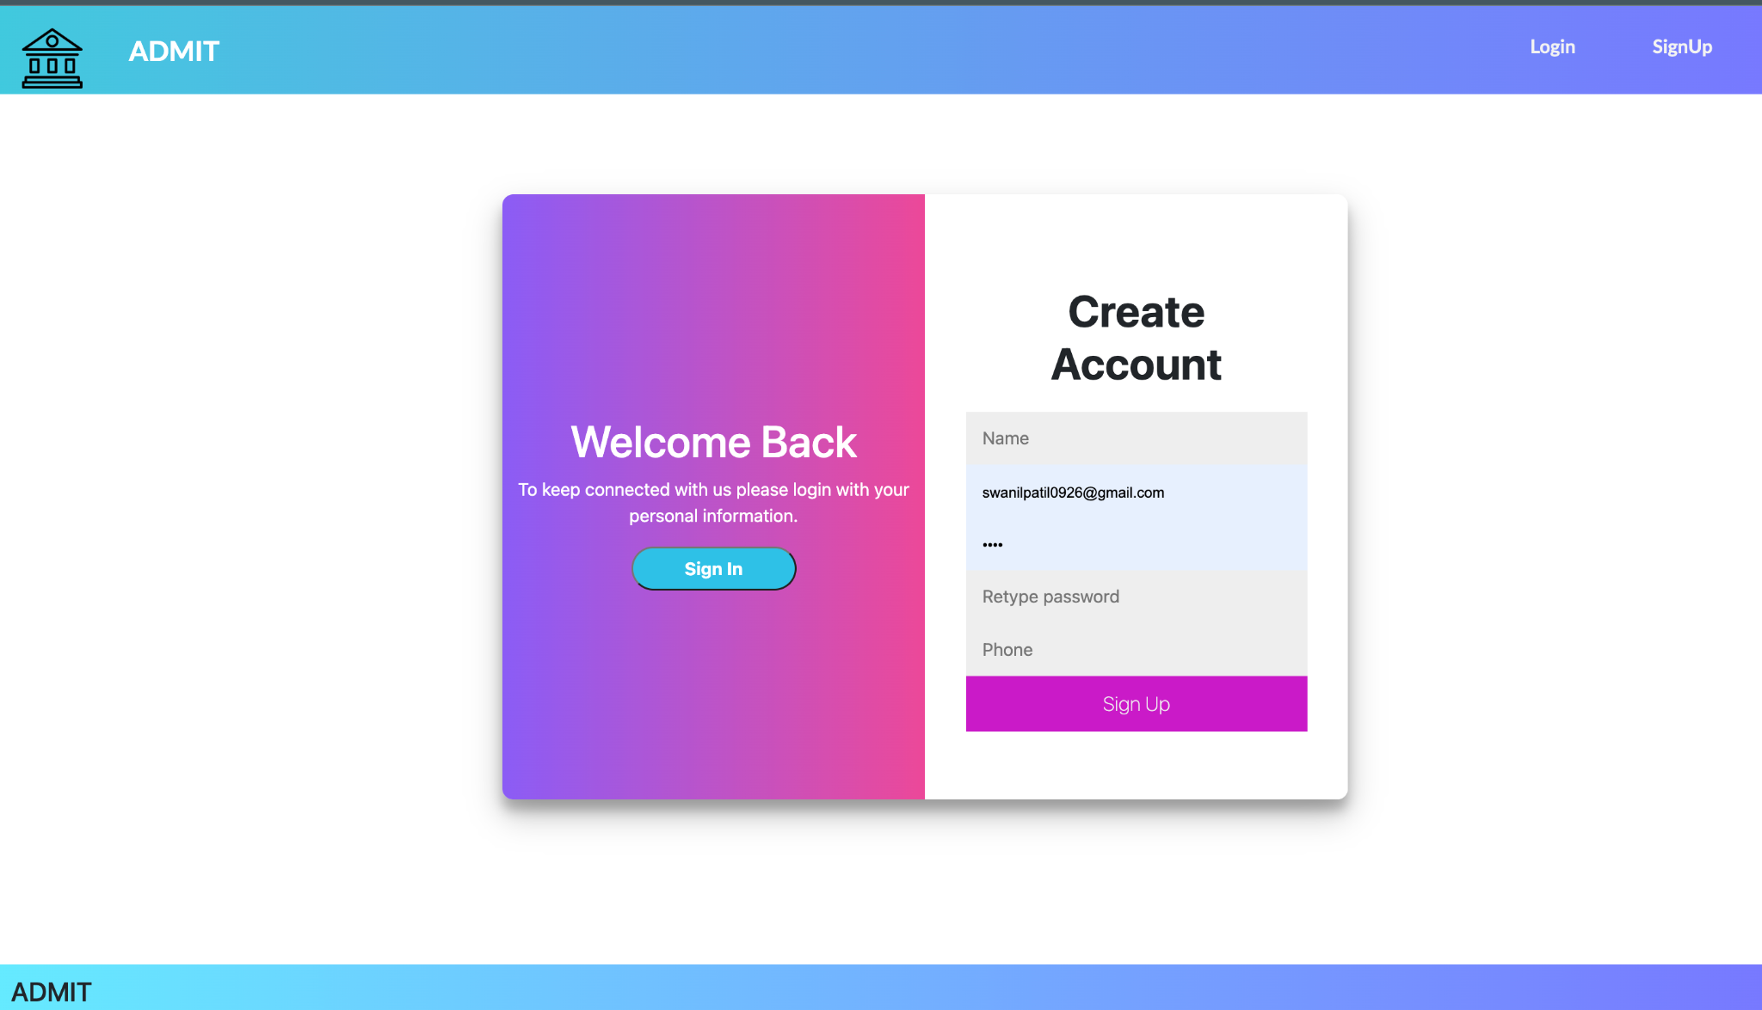
Login & Register

Slide 18
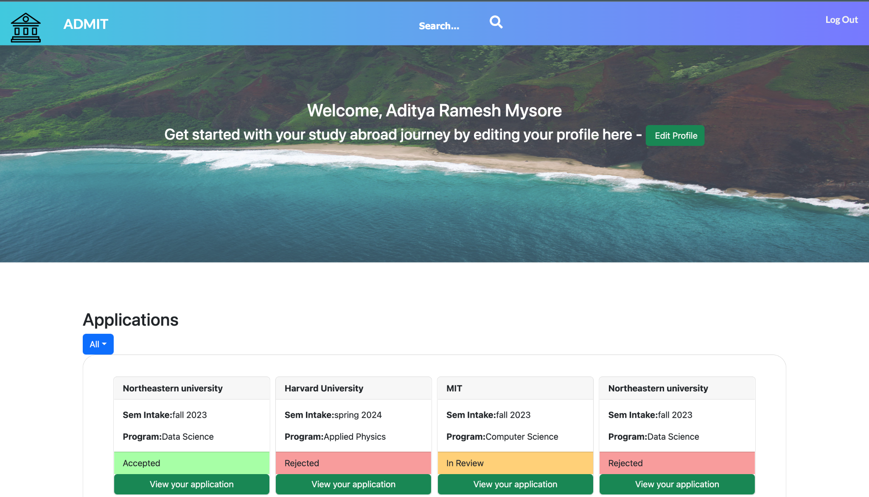
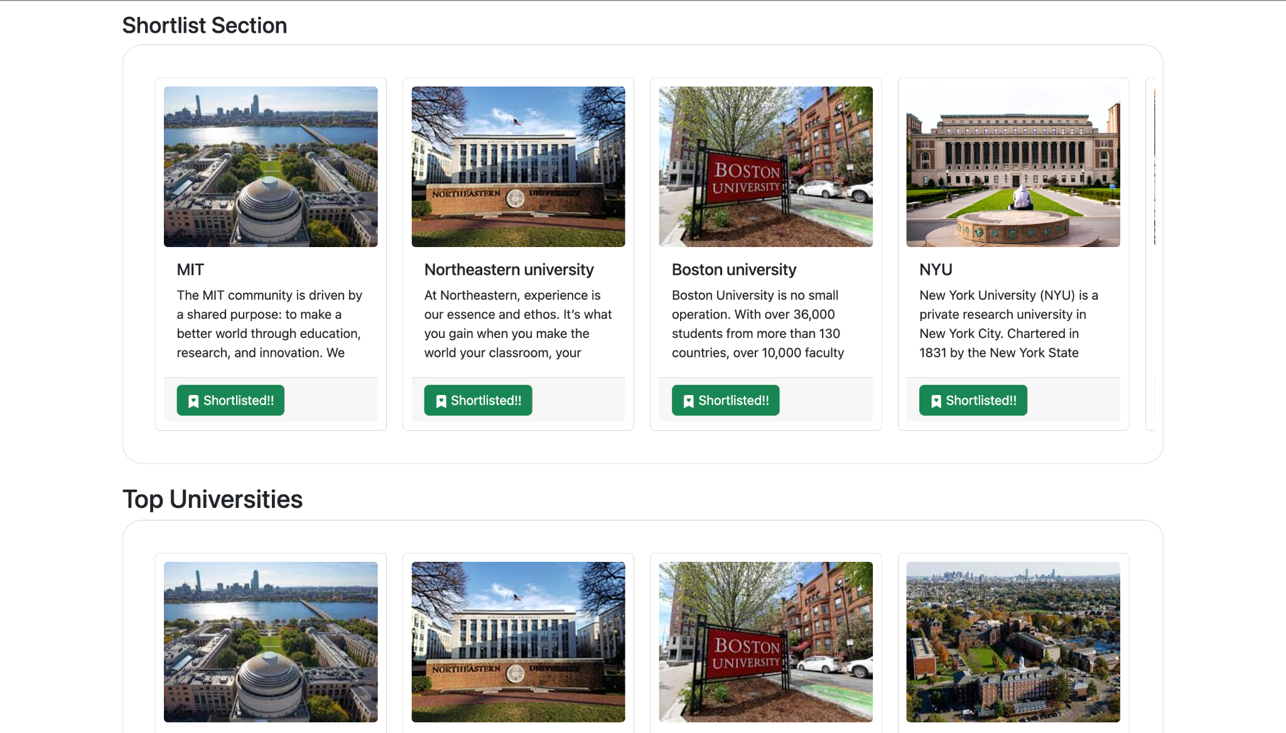

Slide 19
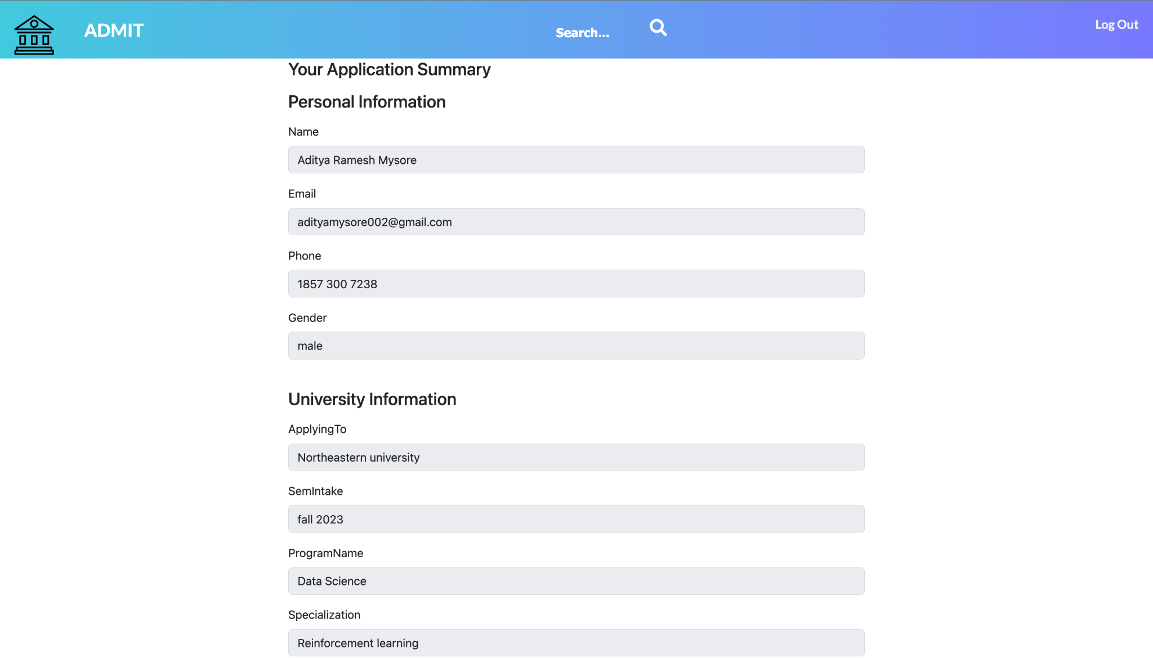
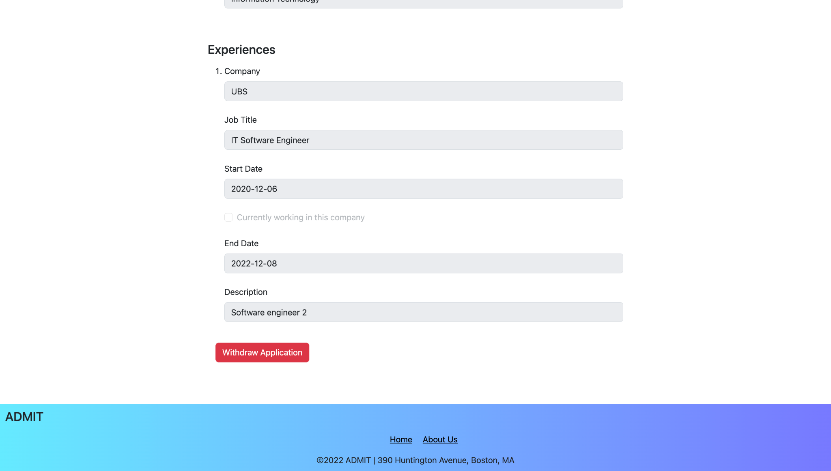
Create, Update & Withdraw Application

Slide 20
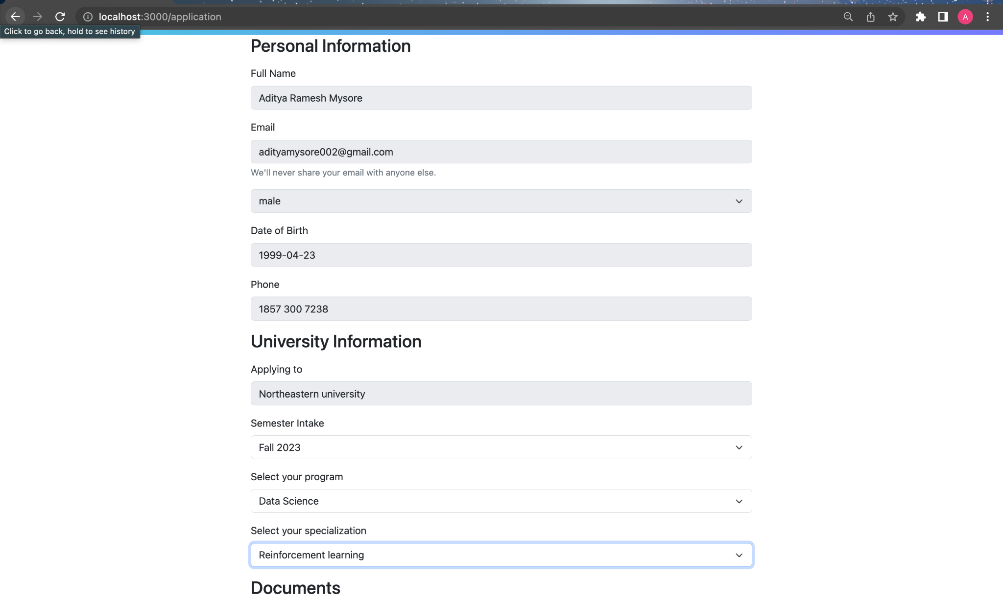
Edit Application

Slide 21
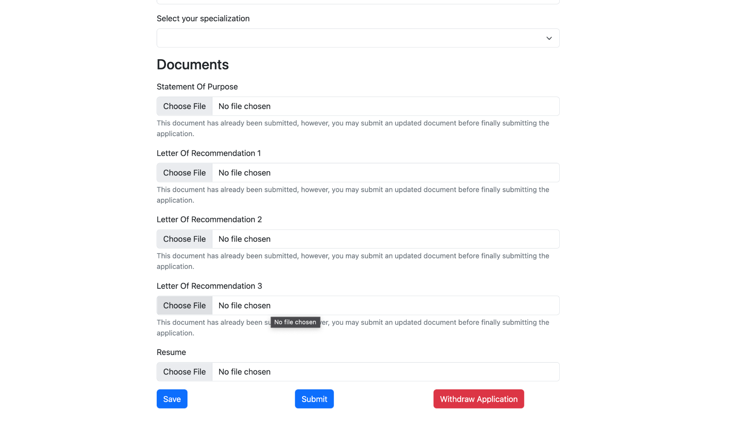
Edit Application

Slide 22
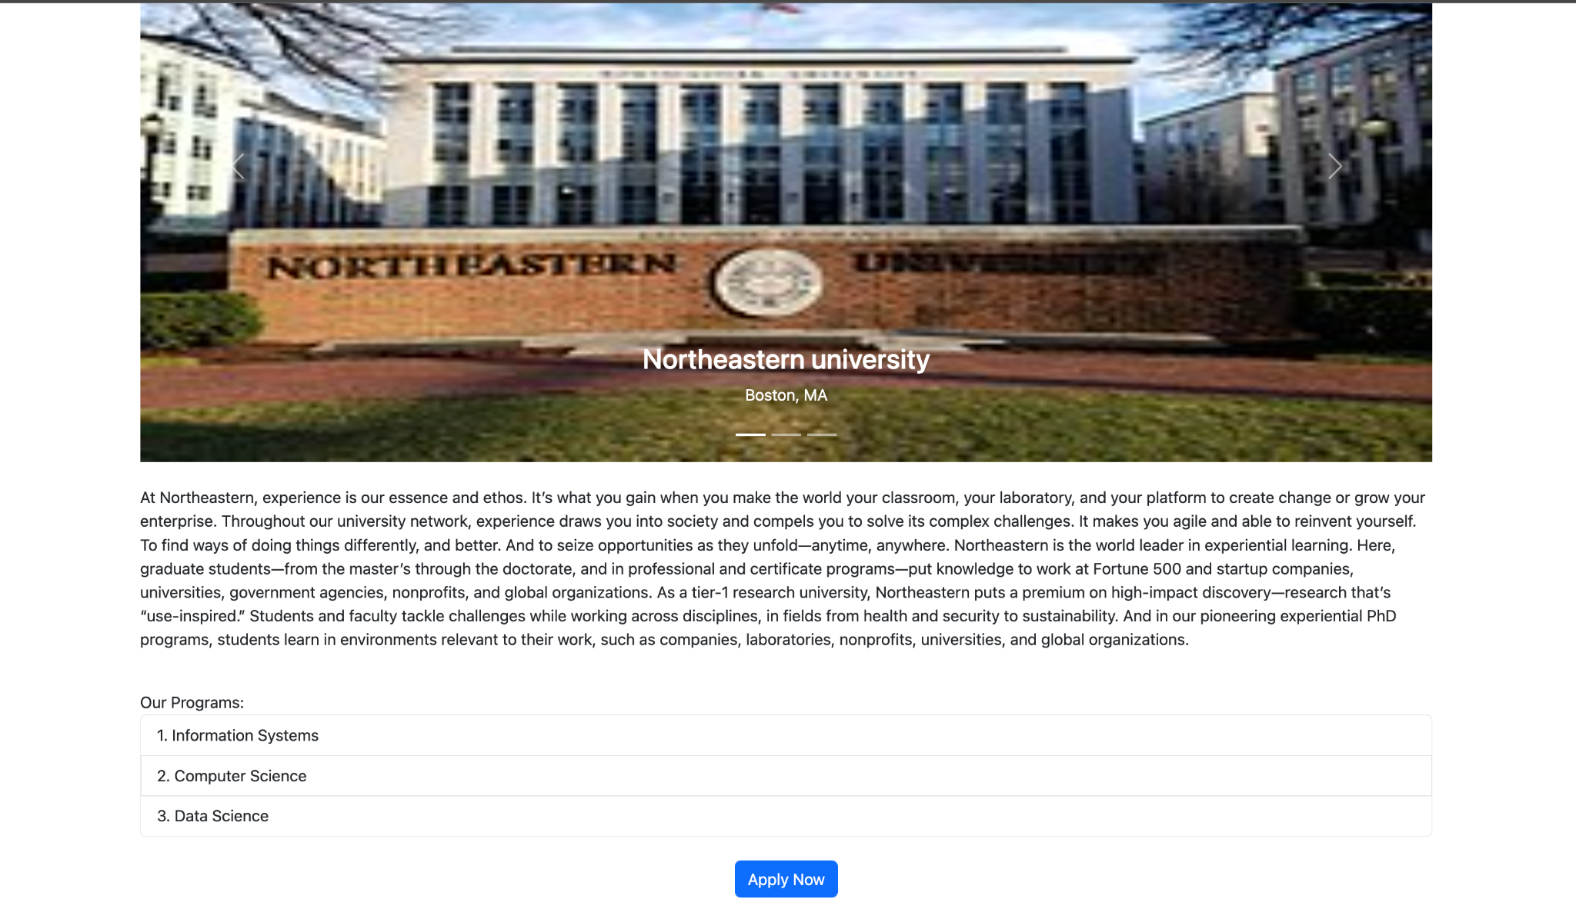
University page

Slide 23
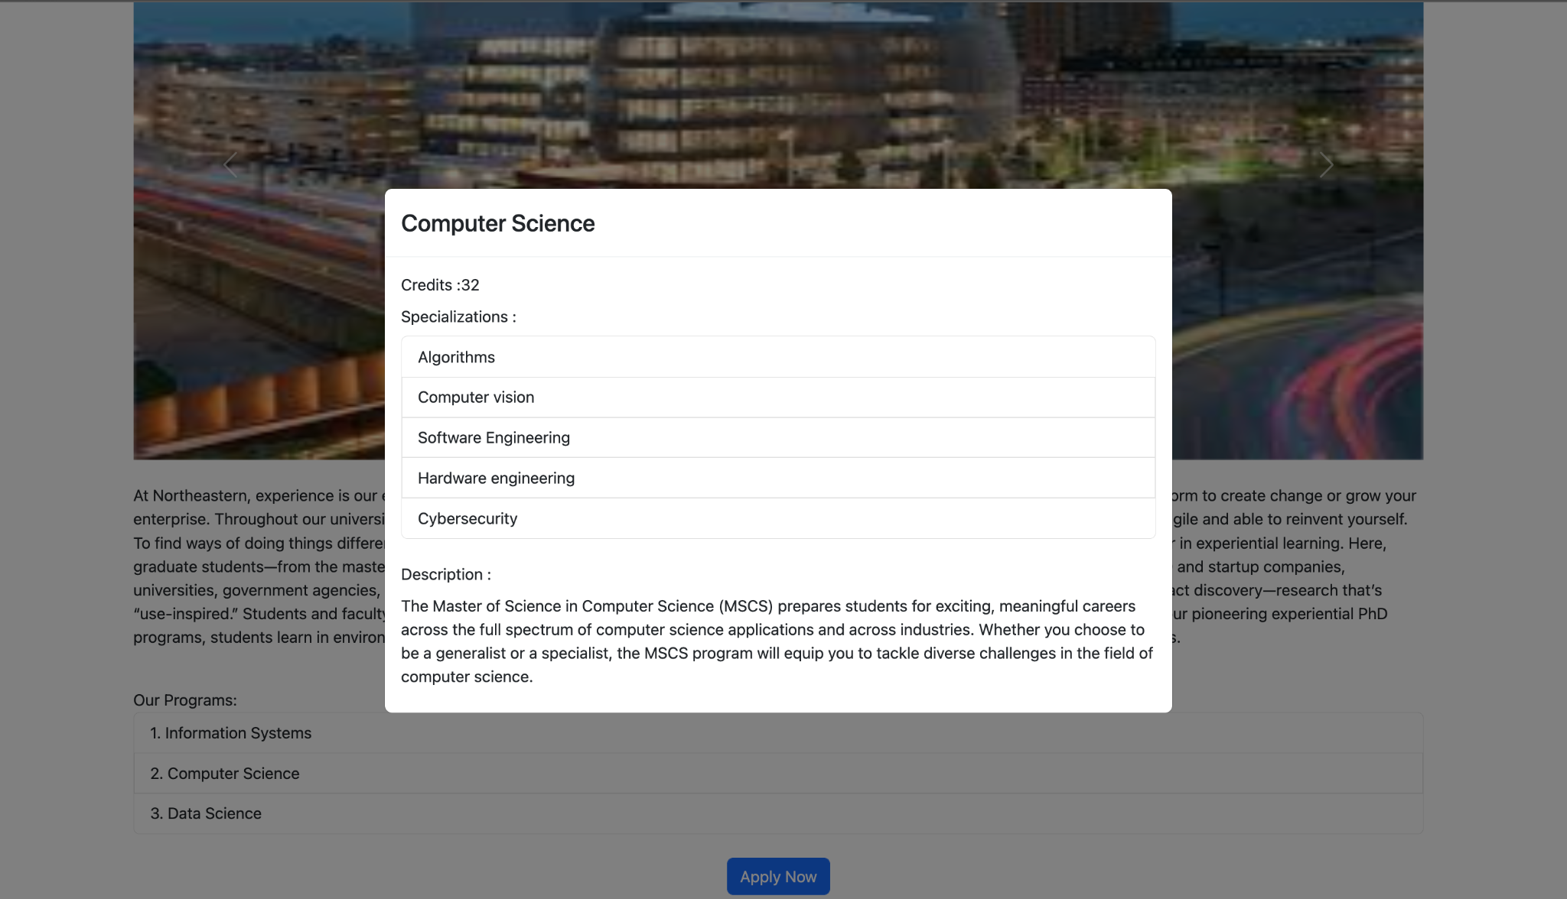
Program description

Slide 24
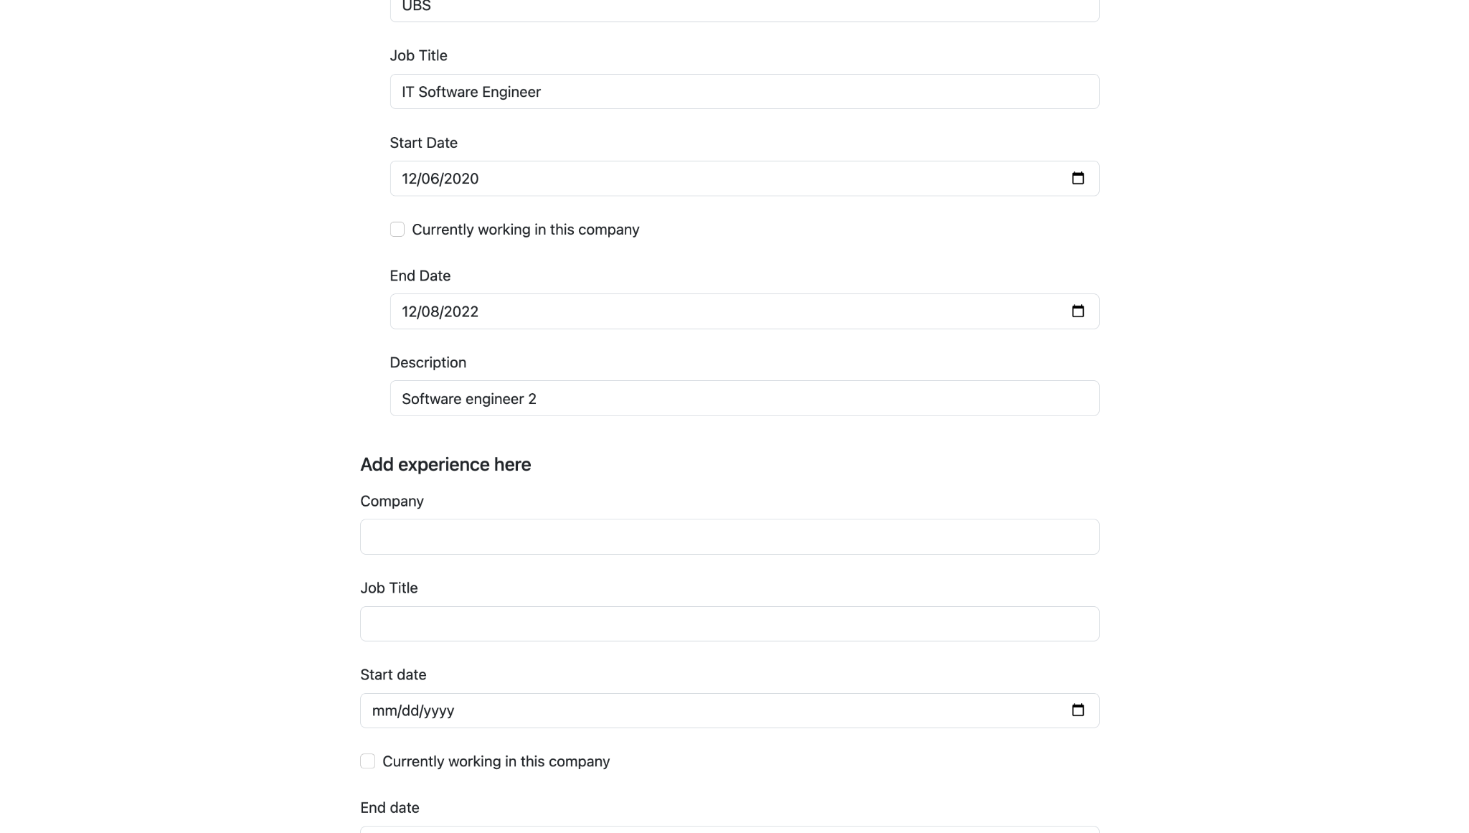
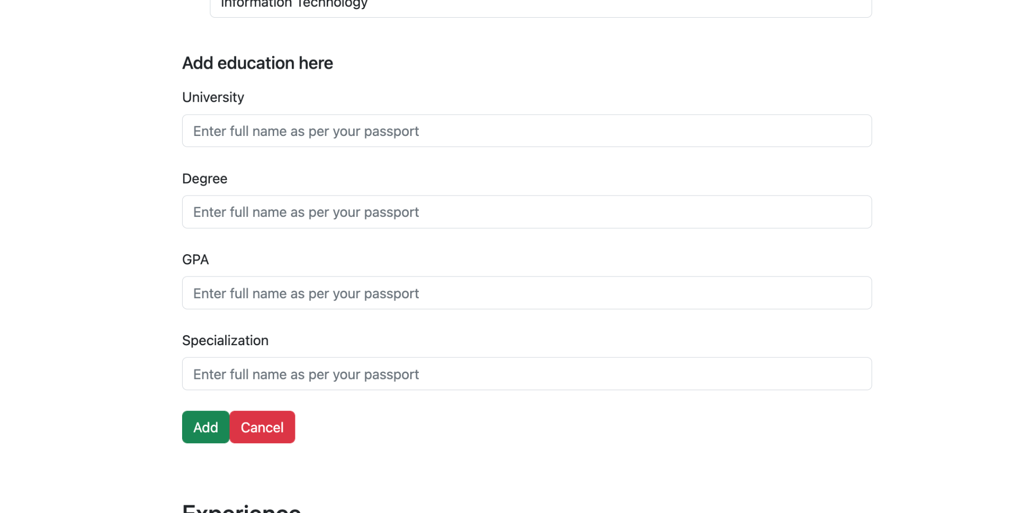
Edit Student Profile

Slide 25
University Admin: Admit/Reject

Slide 26
References
https://reactjs.org/
https://redux-toolkit.js.org/
https://react-bootstrap.github.io/
https://devdocs.io/express/
https://www.mongodb.com/docs/
https://devdocs.io/node/
https://face-recognition.readthedocs.io/en/latest/
https://www.npmjs.com/package/multer
https://jwt.io/introduction

